Slide 1
About me
Name :Sreelatha
Education Background :
Master of Science [M.Sc.(Applied Statistics)].
Why I choose learn Data Science:
Data Science help companies make better decisions by collecting,Organizing and turning Data into insights.Thats why I’m Passionate in Data Science.
Experience:
No experience

Slide 2

Washing Machine Price Analysis

Slide 3
Agenda
Business Problem or Objective of the Project
Web Scraping – Details (Data Collection)
Summary of the Data
Exploratory Data Analysis:
Data Cleaning
Data Manipulation
Univariate Analysis
Bivariate Analysis
Multi variate analysis
Sample Scenarios
Challenges Faced
Conclusion

Slide 4
Business Problem/Objective
Aim is to recommend Best Waching machine Based on
Price,Brand,load,Warrenty and their budget.

Slide 5
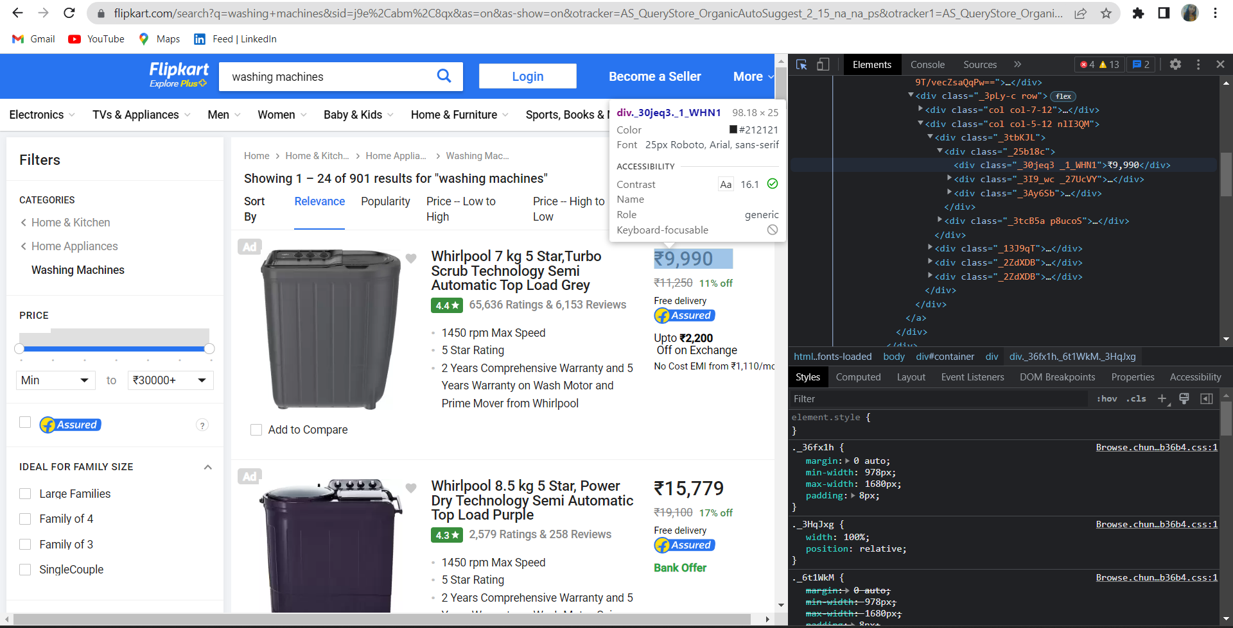
Website used for DataCollection

Slide 6
Required Libraries
Requests
Beautiful Soup
Numpy
Pandas
Regex
Matplotlib
Seaborn

Slide 7
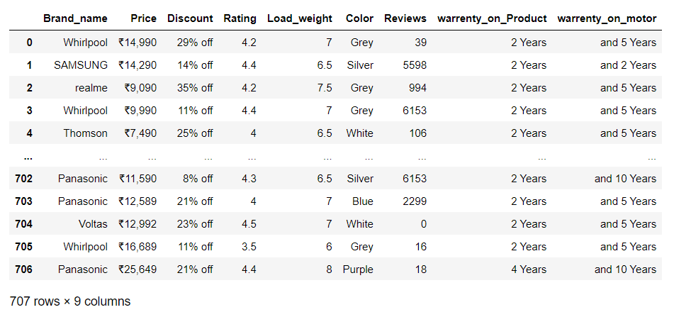
Raw Data

Slide 8
Cleaning Steps
Removing Special characters(,).
Removing Unit characters(%,₹).
Data type Conversions.
Drop the Column.(Unnamed: 0)

Slide 9
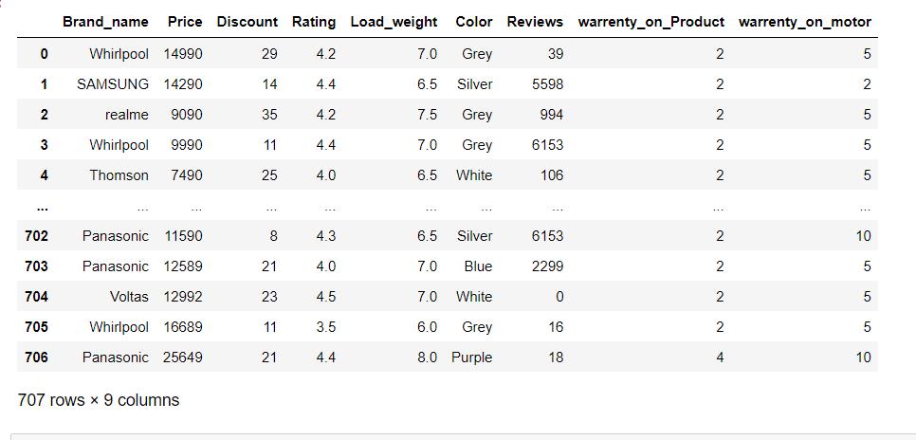
Cleaned Data

Slide 10
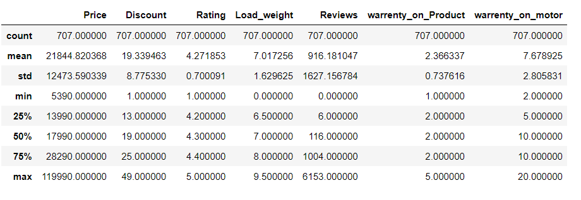
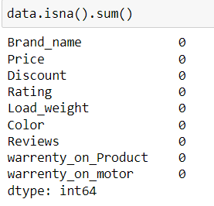
Basic Exploration
Column Name | Data Type
Brand_name | object
Price | int64
Discount | int64
Rating | float64
Load_weight | float64
Color | object
Reviews | int64
Warrenty on Product | int64
Warrenty on Motor | int64

Slide 11
Data Visualization

Slide 12
Types of Analysis:
Uni-Variate Analysis:
The Analysis is done using only one variable.
i.r. either Numerical or Categorical.
Bi-Variate Analysis :
The Analysis is done using two variables.
Possible combinations are:
i.Numerical - Categorical
ii. Numerical - Numerical
iii. Categorical - Categorical
Multi-Variate Analysis :
The analysis is done on more than two variables

Slide 13
Uni-Variate Analysis Single Categorical and Single Numerical

Slide 14
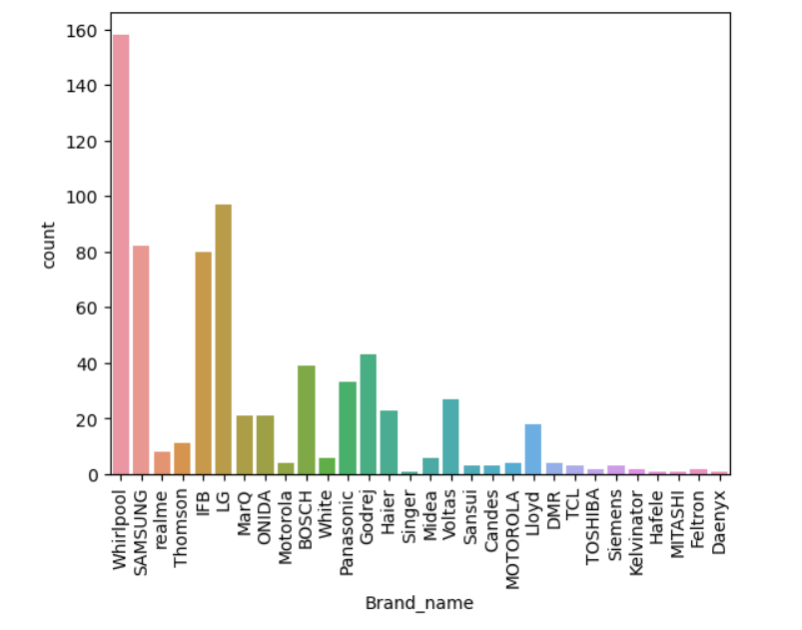
Distribution of Brands
The Whirlpool Brand products are highly avaialble.
The second highest available Product Brand is LG.
Remaining products are belongs to different Brands.

Slide 15
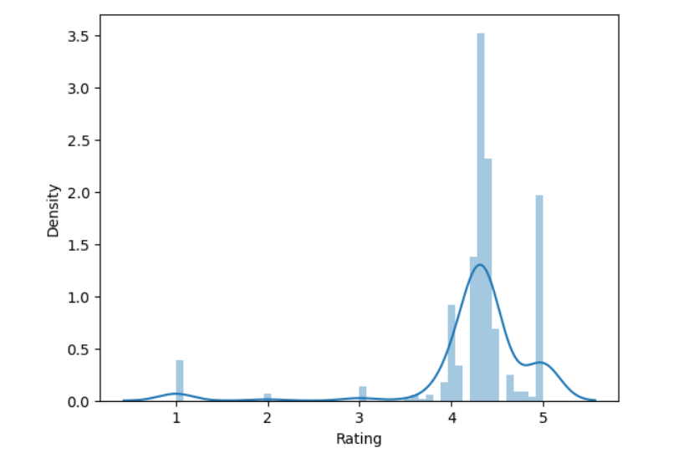
Distribution of Ratings
Most of the Products Ratings are in the range 4.2 to 4.4

Slide 16
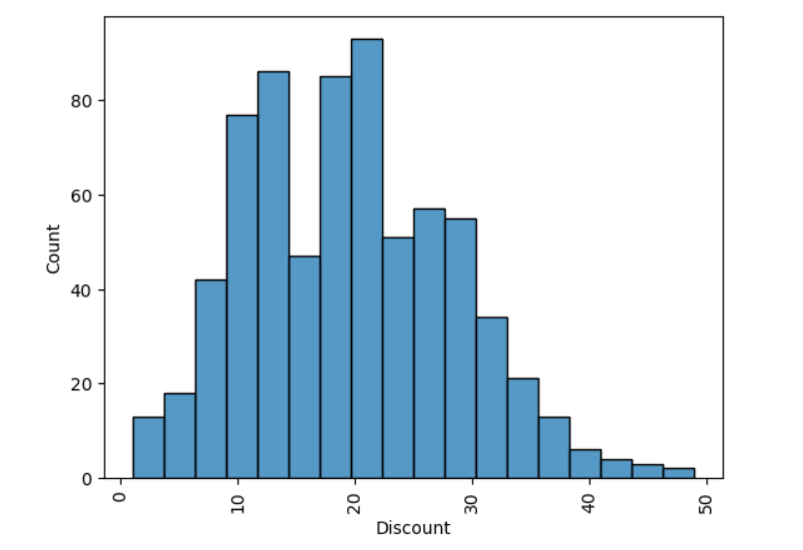
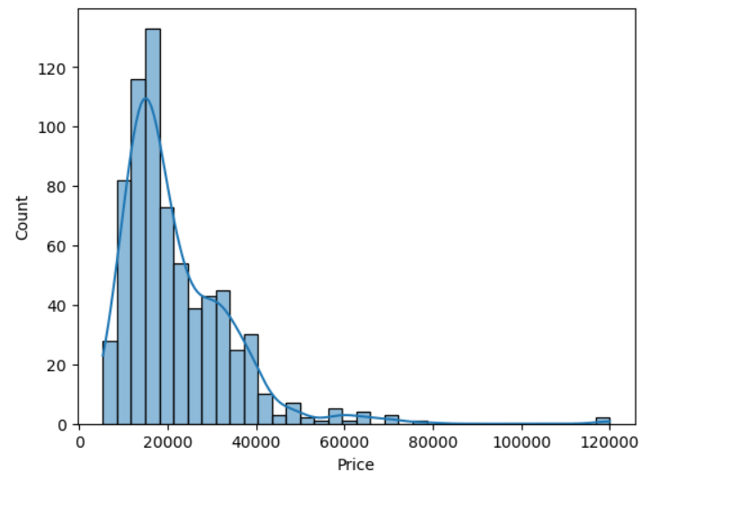
Distributions of Discount and Price
Most of the Products having Discount around 10% to 22% .
Most of the Products are available in the price range from 10k to 40k.

Slide 17
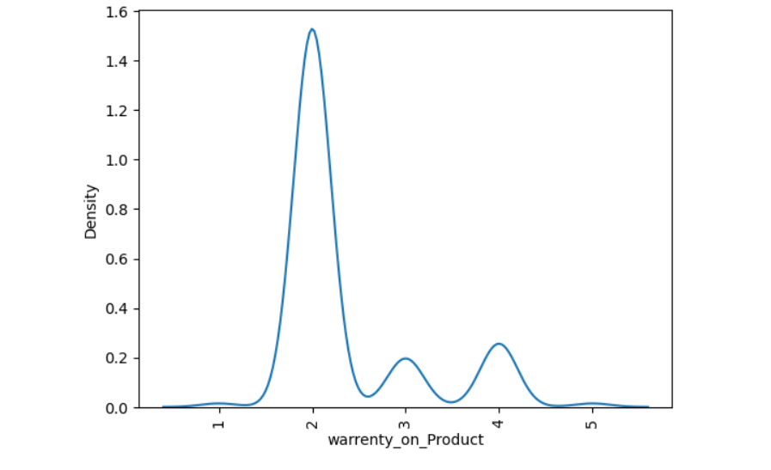
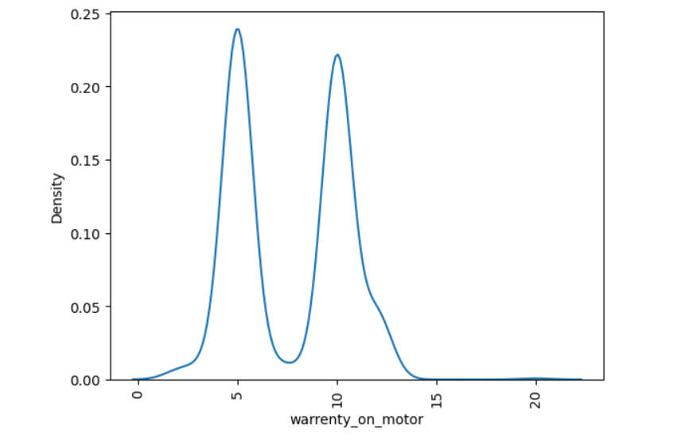
Density of Warrenty on
Products and Motors
The Brand Products has max 2years Warrenty on their products.
The Products are having warrenty for the motor is max 5 or 10 years.

Slide 18
Bi-Variate Analysis
Numerical - Categorical
Numerical - Numerical
Categorical - Categorical

Slide 19
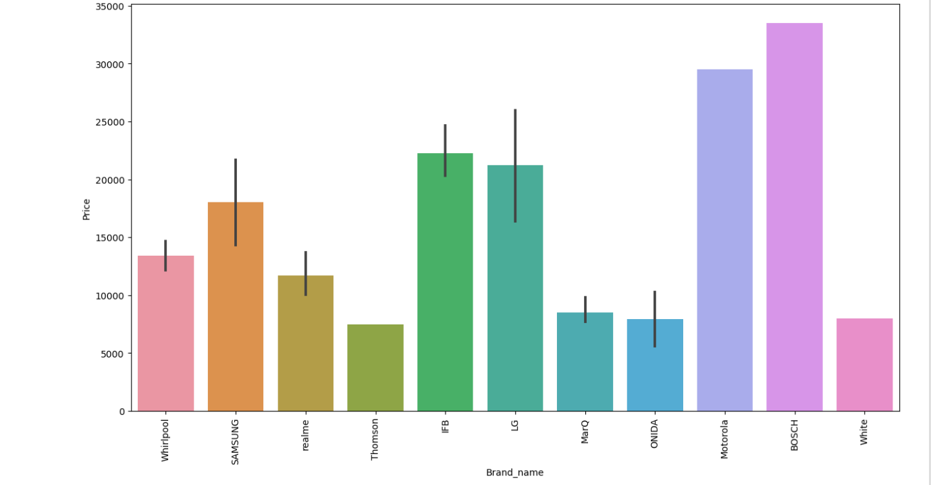
Brand_name vs Price
BOSCH Brand products having highest price while compare with other Brand Products.
The second expensive products are Motorola Brand.
The cheapest products are available on Brand name called Thomson.

Slide 20
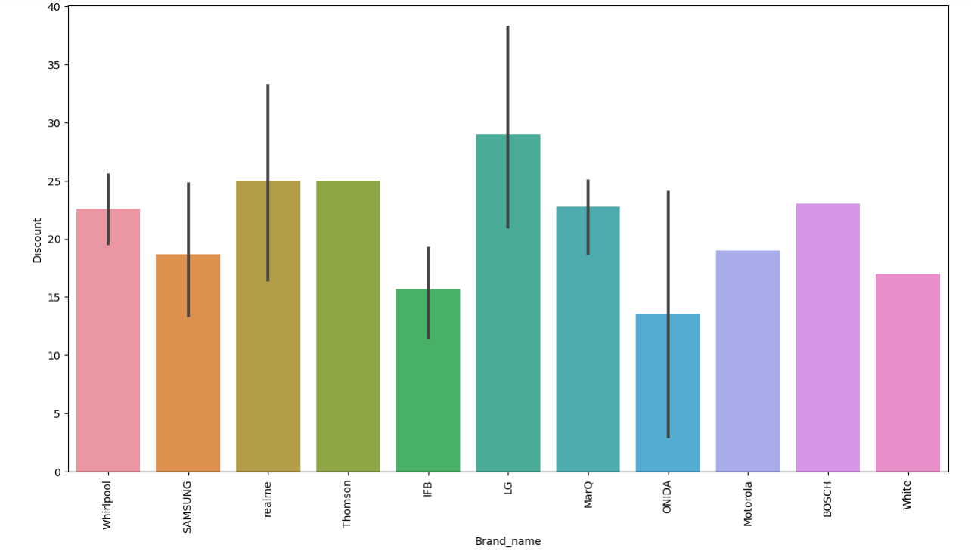
Brand_name vs Discount
LG Brand Products gives us the highest discount upto 25%.
We can also prefer also following products which are having less price and reasonable discount.
1)Thomson 2)Voltas 3)White 4)Whirlpool.

Slide 21
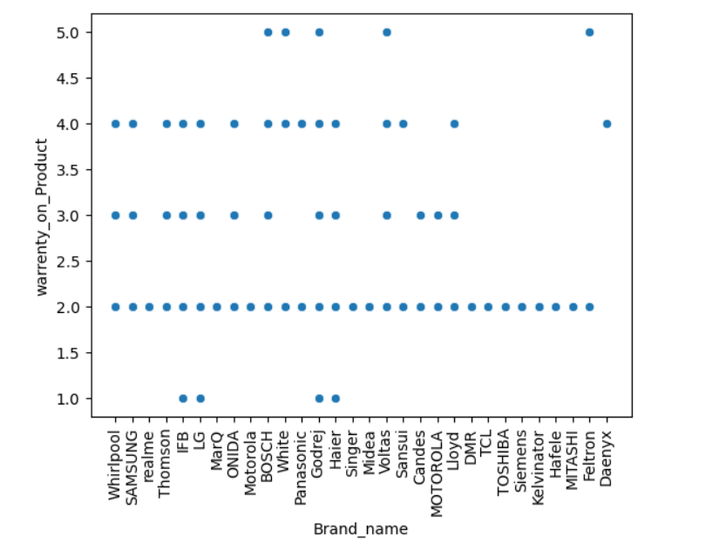
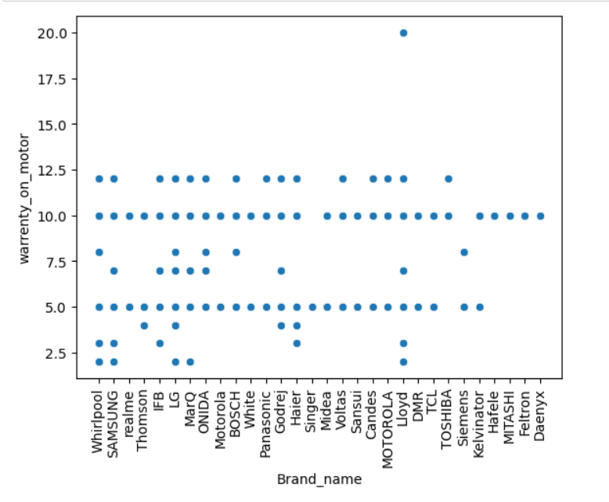
Brand vs Warrenty on Product and Motors
Most of the Brands are giving 2 to 12 years warrenty on their Motors.
Lloyd Brand products giving 20 yrs warrenty no other products giving that much of discount on thier motors.
Most of the Brands are giving 2years warrenty on their products.

Slide 22
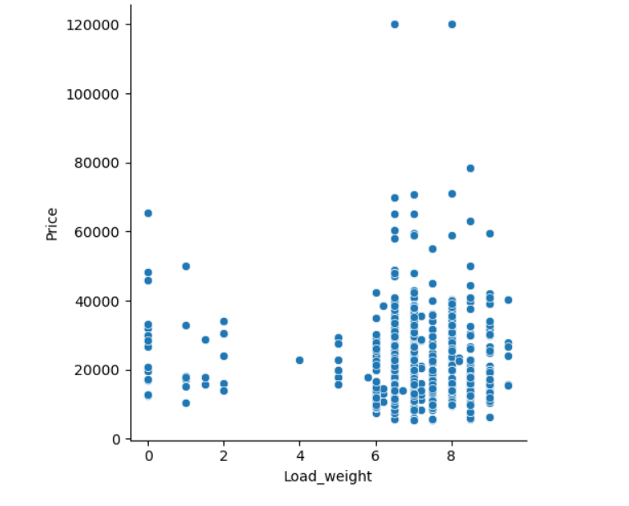
Load_weight vs Price
Products having load_weight on range 6-9kg's are available at all the Prices.(i.e.5k to 80k)
Products which are having 4kg load are available on 22k price only.

Slide 23
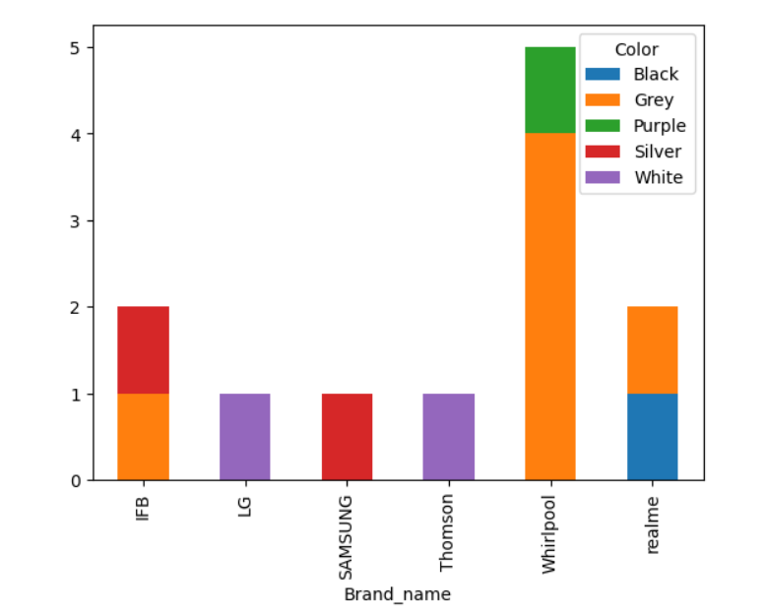
Brand name vs Color
LG and thomson Brand products are available in White color only.
Samsung Brand Products are avaialble in Silver color.

Slide 24
Multi-Variate Analysis

Slide 25
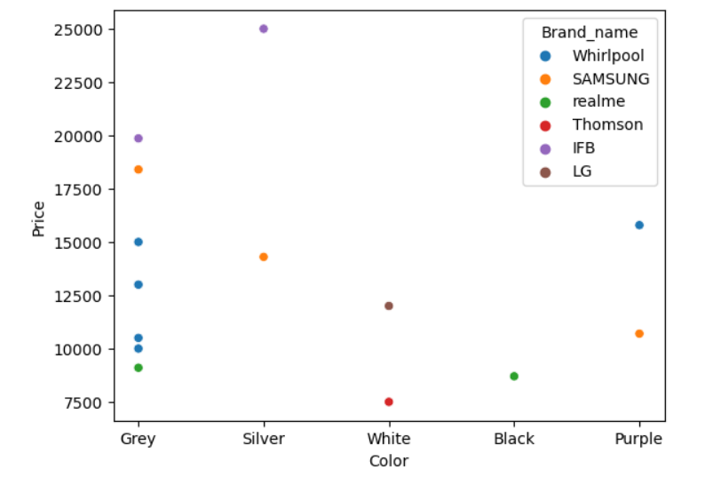
Price and Color vs Brand name
Whirlpool Brand Prodcuts are available with Grey Color in Price Range 10k-15k.
Samsung Brand Products are available with grey,silver and puple colors with different prices

Slide 26
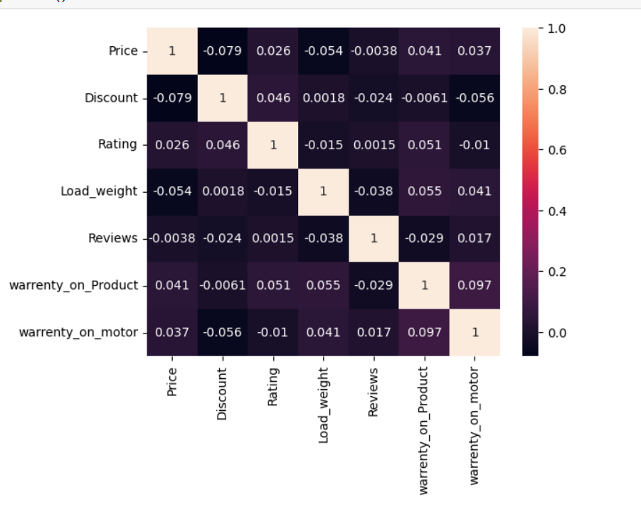
Correlation
Price and Discount has highly negatively correlated.
Discount and Ratings have positively correlated.

Slide 27
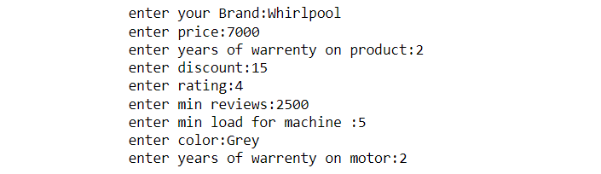
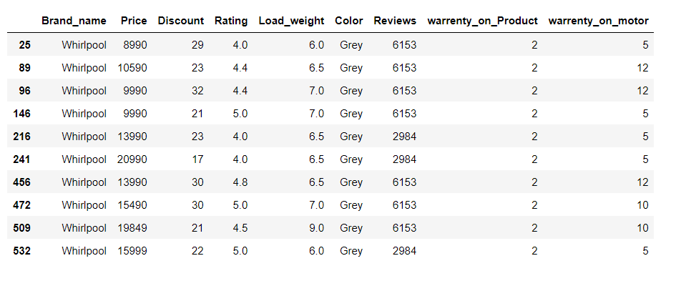
Scenario-1
User Input:

Slide 28
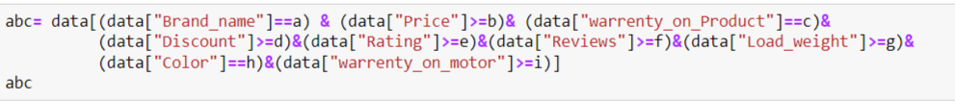
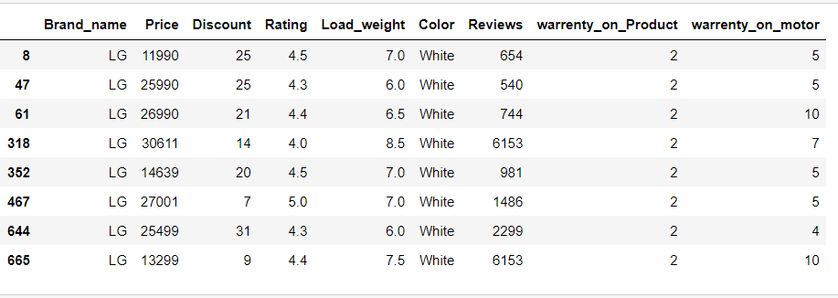
Scenario-2
User Defined:

Slide 29
Conclusion
Before buying a Washing Machine every customer will be having some criteria like Brand, Price, Load weight,Ratings,Warrenty.
Whirlpool and LG brand products are highly available in the Market.
From this analysis Bosch is the expensive Product.
Washing Machine prices starting from 5,000 to 1,19,990.
All Brand products providing maximum 2years warrenty.

Slide 30

THANK YOU

